Slide 1
Web Portal Frameworks
Lecturer: Ngo Huy Bien
Software Engineering Department
Faculty of Information Technology
University of Science
Ho Chi Minh City, Vietnam
nhbien@fit.hcmus.edu.vn

Slide 2

Objectives
To present general web portal framework architecture.

Slide 3

Contents

Slide 4

References
Ulf Pettersson and Stan Jarzabek (2005). Industrial Experience with Building a Web Portal Product Line using a Lightweight, Reactive Approach.
Damith C. Rajapakse and Stan Jarzabek (2007). Using Server Pages to Unify Clones in Web Applications: A Trade-off Analysis. ICSE.

Slide 5
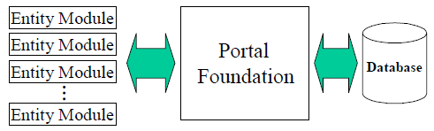
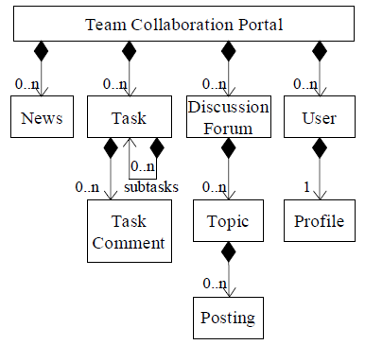
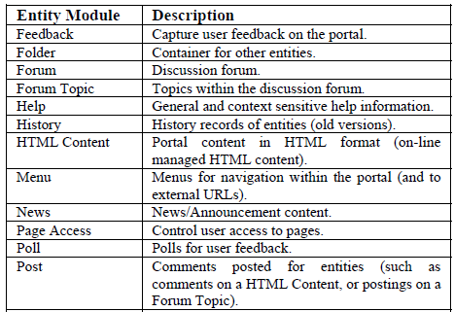
Typical Web App Features [1]
NEW MODULES
(REQUIREMENTS)

Slide 6
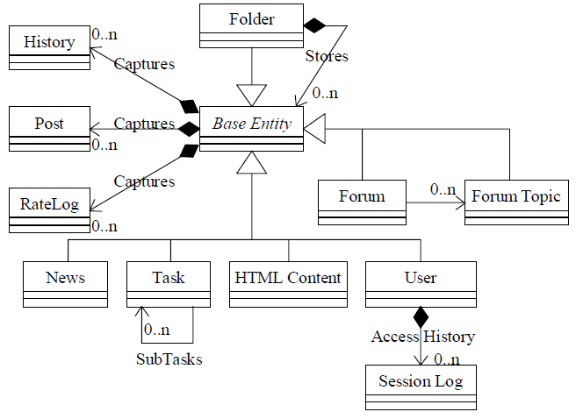
Entity Model Example

Slide 7
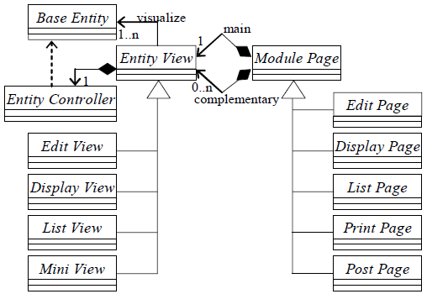
Meta-Model around Base Entity
For each entity (such as News, Task or User) we needed features to:
Create an entity
Edit/update an entity
Delete an entity
Display an entity
Display an entity listing
Capture and display an entity history

Slide 8
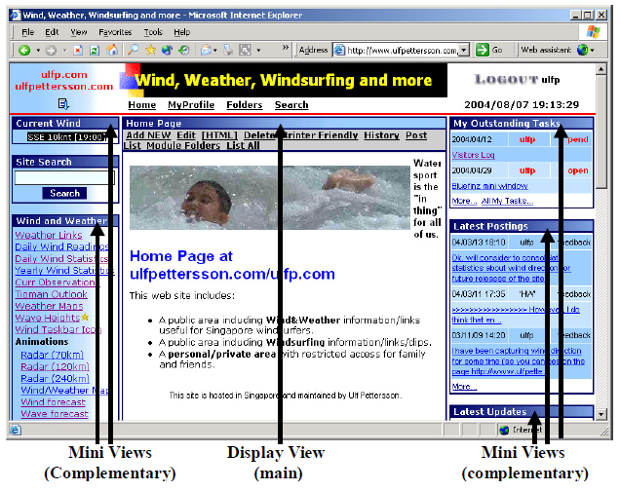
A Web Page Composed by Views

Slide 9
Portal Foundation
The Portal Foundation aimed to simplify the implementation of Entity Modules by providing:
Session and Access Control.
Page formatting.
Site Configuration.
Database persistency, indexing and search.
Support for Base Entity meta-model patterns such as:
Entity visualization and persistency.
Entity indexing (to support generic search feature).
Entity history capturing (to support on-line history archive).

Slide 10
Pros. and Cons.
Ease of Entity Module creation and modification.
The number of clones existing in the Entity Modules.
Complexity risk arising from the needs to handle too many and too complex variants of common functionality.
The product line (a single code base) problem
Some of the required feature enhancements were only applicable (and wanted) in one or a few portals and not in the whole portal family.
Even though some entity modules were required in multiple portals, there were specific variations that applied to each individual portal resulting in difficulties to maintain a single code base.

Slide 11


Slide 12
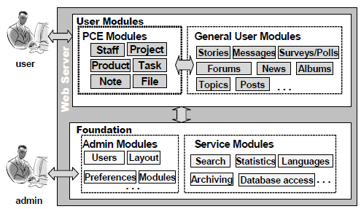
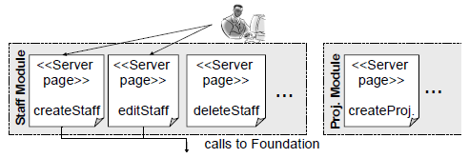
Simple Web Application [2]
We implemented one module and used it to implement other modules by simply cloning it.

Slide 13
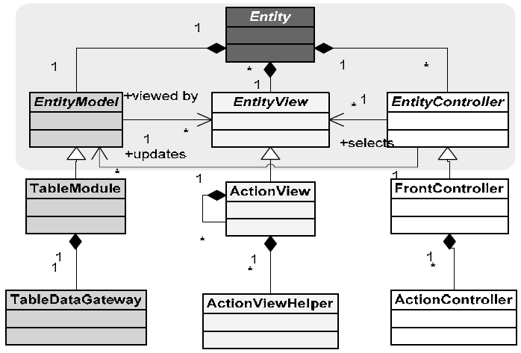
Meta-model of a Module

Slide 14
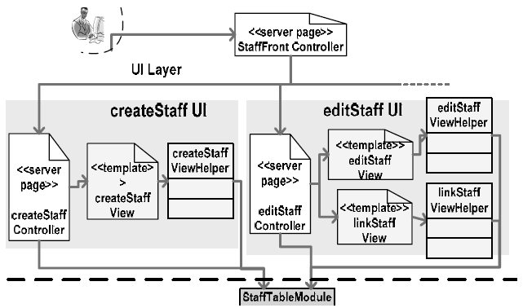
Design of a Module: Front Controller and Page Controller
FrontController. Similar preprocessing sequences were repeated for each page request (e.g., session validation, parameter decoding).
ActionController. Control the complexity of controllers.

Slide 15
Design of a Module: Template View
ActionView. Some views exhibited much similarity among them.
We put the similar parts of views in to a template.

Slide 16
Design of a Module: View Helper
ActionViewHelper. Data retrieval code was cloned in multiple views.

Slide 17
Design of a Module: Composite View
Some fragments of UI recurred in multiple places

Slide 18
Design of a Module: Table Module and Table Data Gateway
TableModule and TableDataGateway. Each module has minimal domain logic and is represented in the database as a single table.

Slide 19
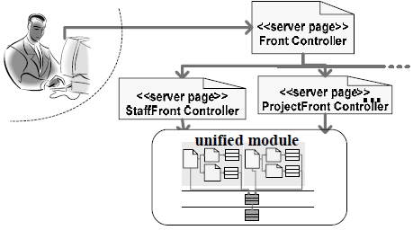
Generic Module
We pulled the six Front Controllers out of the modules and unified clones among them by creating two layers of Controllers.
The top layer consisted of a common Front Controller that unified common control tasks.
The second layer consisted of six module-specific controllers (e.g., StaffFrontController, ProjectFrontController, …).

Slide 21
Web Application Framework Criteria
Reusability
Authentication, authorization, modules
Extensibility
Source lines of code
Scalability
Number of serving users
Performance
Response time

Slide 22

Thank You & See You Again

